Slide 1
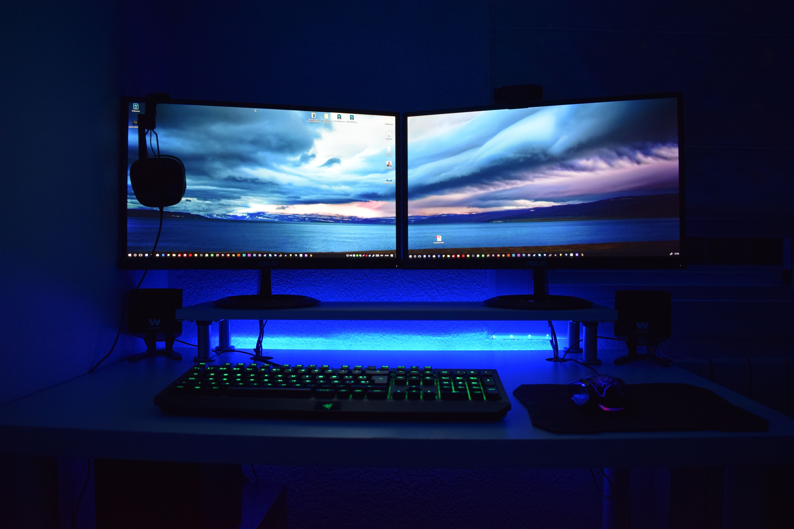
Moonstone Games
Studio Review
Burn rate, runway, and the path to Early Access
Prepared by Carlos Foster | as of 21 February 2026

Slide 2
Snapshot
$45,000
invested to date
$2,800
monthly burn
8 months
runway remaining
1,200
demo wishlists
Cash position
The studio has roughly $22,400 in working cash against a steady $2,800 monthly burn, leaving about eight months before revenue or a deal is needed. Carlos draws nothing from the studio and covers personal costs from freelance income.

Slide 3
Monthly burn breakdown
Total monthly burn: $2,800

Slide 4
Personal monthly budget
Income vs outgoings
Freelance pixel art brings in about $2,200 a month against $2,345 in personal costs, a small monthly gap of $145 that draws gently on savings.
Emergency fund holds steady at $12,040 earning 4.0% APY.

Slide 5
Freelance income, recent months

Slide 6
Runway projection
Working cash at $2,800 monthly burn, no new revenue assumed

Slide 7
Festival and submission spend
Festival | Fee | Submitted | Status
Indie Horizons Expo | $95 | 1 Dec 2025 | accepted
Cascade Play Festival | $75 | 20 Nov 2025 | accepted
Northwest Game Showcase | $60 | 15 Jan 2026 | pending
Driftwood Indie Awards | $40 | 5 Feb 2026 | submitted
A $300 monthly reserve covers booth fees and travel. The larger PAX booth at $3,000 stays parked until a deal or a strong launch funds it.

Slide 8
Decisions this quarter
Target November 2026
Lock Early Access for November and build the store page in October.
Hold publisher talks
Keep the conversation warm but send no build without sign off.
Protect the runway
Defer the large booth, keep burn at $2,800, revisit at launch.
Consider the LLC
Form the Washington studio entity before any deal closes.

Slide 9
Cash position and runway
As of 21 February 2026
Metric | Value
Working cash | $22,400
Monthly burn | $2,800
Runway (cash / burn) | 8.0 months
Invested to date | $45,000
Emergency fund (personal) | $12,040 @ 4.0% APY
• Runway is derived, not a headline: 22,400 / 2,800 = 8.0 months.
• Carlos draws nothing from the studio; personal costs run on freelance income.
• No borrowing against the studio. The refit-style spend does not apply here.
• PAX booth at $3,000 stays parked until a deal or a strong launch funds it.

Slide 10
Monthly burn breakdown
Total $2,800 per month
Category | Monthly USD | % of burn
Composer contract | $1,000 | 35.7%
Software licenses | $350 | 12.5%
Hardware amortized | $250 | 8.9%
Marketing | $500 | 17.9%
Analytics hosting | $200 | 7.1%
Festival reserve | $300 | 10.7%
Contingency | $200 | 7.1%
TOTAL | $2,800 | 100%

Slide 11
The three paths
Weighed at the interest stage, no terms yet
Path | Runway effect | Control | Status
Ember Gate deal | advance extends, terms open | share negotiated | non-binding EOI, Feb 9
Pixel North deal | advance extends, terms open | share negotiated | wants to see EA build
Self-publish | booth + marketing shorten it | full | Tyler's preference
• No written deal terms from either publisher, so deal economics are modeled as scenarios and held open.
• Decision deferred until the numbers are trued up. First contact stays with Carlos.

